Slide 1
Chapter 2: Scaling VLANs
Instructor Materials
CCNA Routing and Switching
Scaling Networks v6.0
Notes:
Cisco Networking Academy Program
Scaling Networks v6.0
Chapter 2: Scaling VLANs

Slide 2
Instructor Materials – Chapter 2 Planning Guide
This PowerPoint deck is divided in two parts:
Instructor Planning Guide
Information to help you become familiar with the chapter
Teaching aids
Instructor Class Presentation
Optional slides that you can use in the classroom
Begins on slide # 12
Note: Remove the Planning Guide from this presentation before sharing with anyone.
Notes:
2

Slide 3
Chapter 2: Scaling VLANs
Scaling networks 6.0 Planning Guide
Notes:
Cisco Networking Academy Program
Scaling Networks v6.0
Chapter 2: Scaling VLANs

Slide 4
Chapter 2: Activities
What activities are associated with this chapter?
Page # | Activity Type | Activity Name | Optional?
2.1.1.7 | Interactive Activity | Identify VTP Concepts and Operations | Recommended
2.1.2.6 | Syntax Checker | Configure and Verify VTP | Recommended
2.1.3.2 | Syntax Checker | Create and Verify a VLAN | Recommended
2.1.3.3 | Syntax Checker | Assign Ports to VLANs | Recommended
2.1.3.4 | Syntax Checker | Verify VLAN Information | Recommended
2.1.3.5 | Syntax Checker | Configure and Verify an Extended VLAN | Recommended
2.1.4.2 | Syntax Checker | Verifying DTP Mode | Recommended
2.1.4.3 | Interactive Activity | Predict DTP Behavior | Recommended
2.1.4.4 | Packet Tracer | Configure VLANs, VTP, and DTP | Optional
2.1.4.5 | Lab | Configure Extended VLANs, VTP, and DTP | Recommended
The password used in the Packet Tracer activities in this chapter is: PT_ccna5
Notes:
4

Slide 5
Chapter 2: Activities (Cont.)
What activities are associated with this chapter?
Page # | Activity Type | Activity Name | Optional?
2.2.2.3 | Interactive Activity | Identify the Troubleshooting Command for an Inter-VLAN Routing Issue | Recommended
2.2.2.4 | Packet Tracer | Troubleshooting Inter-VLAN Routing | Recommended
2.2.2.5 | Lab | Troubleshoot Inter-VLAN Routing | Optional
2.2.3.3 | Packet Tracer | Troubleshoot VTP and DTP Issues | Recommended
2.3.1.5 | Packet Tracer | Configure Layer 3 Switching and inter-VLAN Routing | Recommended
2.3.2.3 | Interactive Activity | Troubleshoot Layer 3 Switching Issues | Recommended
The password used in the Packet Tracer activities in this chapter is: PT_ccna5
Notes:
5

Slide 6
Chapter 2: Assessment
Students should complete Chapter 2, “Assessment” after completing Chapter 2.
Quizzes, labs, Packet Tracers and other activities can be used to informally assess student progress.
Notes:
6

Slide 7
Chapter 2: Best Practices
Prior to teaching Chapter 2, the instructor should:
Complete Chapter 2, “Assessment.”
The objectives of this chapter are:
Compare VTP versions 1 and 2.
Configure VTP versions 1 and 2.
Configure extended VLANs.
Configure Dynamic Trunking Protocol (DTP).
Troubleshoot common inter-VLAN configuration issues.
Troubleshoot common IP addressing issues in an inter-VLAN routed environment.
Troubleshoot common VTP and DTP issues in an inter-VLAN routed environment.
Configure inter-VLAN routing using Layer 3 switching.
Troubleshoot inter-VLAN routing in a Layer 3 switched environment.
Notes:
7

Slide 8
Chapter 2: Best Practices (Cont.)
2.1
Make this chapter as hands on as possible. Students should complete all the recommended labs, Packet Tracer activities, and other activities.
Emphasize the importance and advantages of switches now being widely used as Layer 3 devices.
Create the topology in 2.1.2.1 and demonstrate the steps to configure VTP.
Point out the changes in the configuration revision number when VLANs are added.
Discuss and demonstrate the problems that can occur when adding a switch with a higher configuration revision number to a VTP network.
Explain how this can be resolved.
Discuss DTP and demonstrate the different interface settings and resulting negotiated trunk modes.
Note that trunks should be statically configured when possible.
Notes:
8

Slide 9
Chapter 2: Best Practices (Cont.)
2.2
Review creating and deleting VLANs and demonstrate potential problems.
Review router-on-a-stick inter-VLAN routing topology in Packet Tracer and point out the issues that can occur.
After students have completed the troubleshooting labs, create additional troubleshooting challenges in Packet Tracer and/or have one team of students create problems on another team’s setup. Ensure that all changes and all solutions are documented.
2.3
Review the Core, Distribution and Access network model and discuss the use of Layer 3 switches.
Replace the router in the router on-a-stick Inter-VLAN demo Packet Tracer you created with a Layer 3 switch and demonstrate the configuration.
Recommend that students complete activity 5.3.2.3
Notes:
9

Slide 10
Chapter 2: Additional Help
For additional help with teaching strategies, including lesson plans, analogies for difficult concepts, and discussion topics, visit the CCNA Community at: https://www.netacad.com/group/communities/community-home
Best practices from around the world for teaching CCNA Routing and Switching. https://www.netacad.com/group/communities/ccna
If you have lesson plans or resources that you would like to share, upload them to the CCNA Community in order to help other instructors.
Students can enroll in Introduction to Packet Tracer (self-paced).
Notes:
10

Slide 12
Chapter 2: Scaling VLANs
CCNA Routing and Switching
Scaling Networks v6.0
Notes:
Cisco Networking Academy Program
Scaling Networks v6.0
Chapter 2: Scaling VLANs

Slide 13
Chapter 2 - Sections & Objectives
2.1 VTP, Extended VLANs, and DTP
Configure enhanced inter-switch connectivity technologies.
Compare VTP versions 1 and 2.
Configure VTP versions 1 and 2.
Configure extended VLANs.
Configure Dynamic Trunking Protocol (DTP).
2.2 Troubleshoot Multi-VLAN Issues
Troubleshoot issues in an inter-VLAN routing environment.
Troubleshoot common inter-VLAN configuration issues.
Troubleshoot common IP addressing issues in an inter-VLAN routed environment.
Troubleshoot common VTP and DTP issues in an inter-VLAN routed environment.
Notes:
13
Cisco Networking Academy Program
Scaling Networks v6.0
Chapter 2: Scaling VLANs

Slide 14
Chapter 2 - Sections & Objectives (Cont.)
2.3 Layer 3 Switching
Implement inter-VLAN routing using Layer 3 switching to forward data in a small to medium-sized business LAN.
Configure inter-VLAN routing using Layer 3 switching.
Troubleshoot inter-VLAN routing in a Layer 3 switched environment.
Notes:
14
Cisco Networking Academy Program
Scaling Networks v6.0
Chapter 2: Scaling VLANs

Slide 15
2.1 VTP, Extended VLANs, and DTP
Notes:
2 – Scaling VLANs
2.1 – VTP, Extended VLANs, and DTP

Slide 16
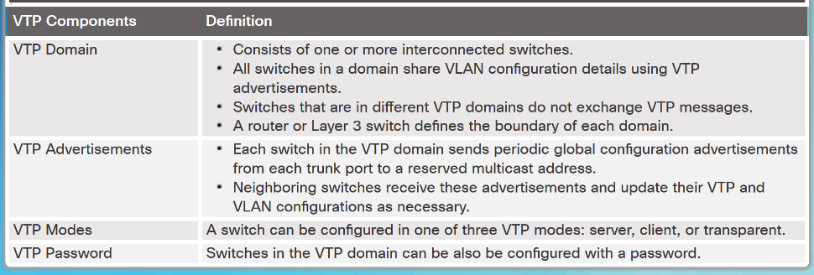
VTP Concepts and Operation VTP Overview
VLAN trunking protocol (VTP) allows a network administrator to manage VLANs on a switch configured as a VTP server.
The VTP server distributes and synchronizes VLAN information over trunk links to VTP-enabled switches throughout the switched network.
Notes:
2.1 – VTP, Extended VLANs, and DTP
2.1.1 – VTP Concepts and Operation
2.1.1.1 – VTP Overview

Slide 17
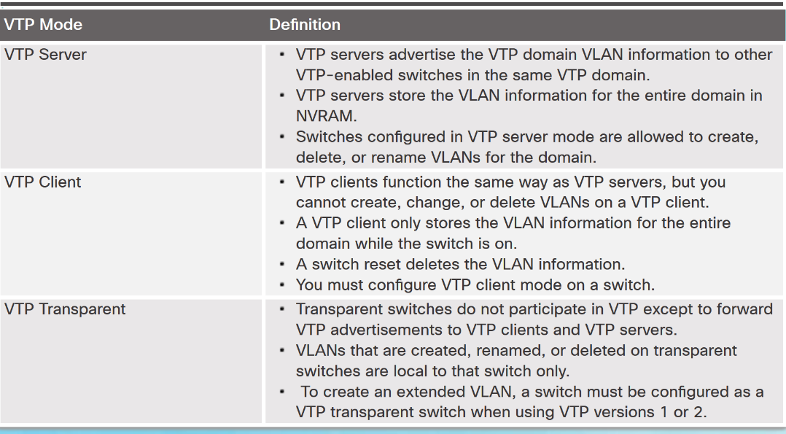
VTP Concepts and Operation VTP Modes
Notes:
2.1 – VTP, Extended VLANs, and DTP
2.1.1 – VTP Concepts and Operation
2.1.1.2 – VTP Modes

Slide 18
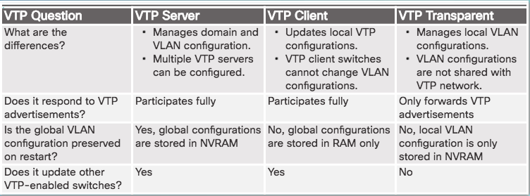
VTP Concepts and Operation VTP Modes (Cont.)
Notes:
2.1 – VTP, Extended VLANs, and DTP
2.1.1 – VTP Concepts and Operation
2.1.1.2 – VTP Modes

Slide 19
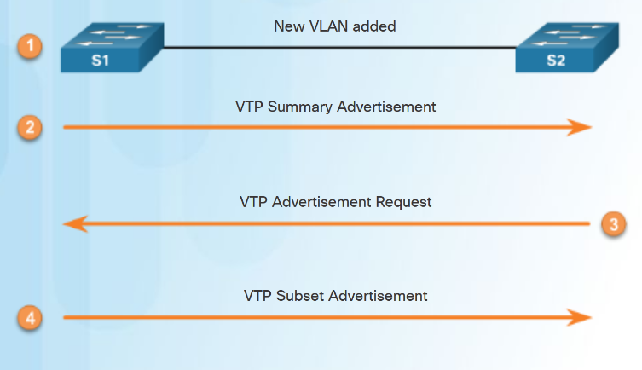
VTP Concepts and Operation VTP Advertisements
Three types of VTP Advertisements:
Summary advertisements – contain VTP domain name and configuration revision number.
Advertisement request - response to a summary advertisement message when the summary advertisement contains a higher configuration revision number than the current value.
Subset advertisements - contain VLAN information including any changes.
Notes:
2.1 – VTP, Extended VLANs, and DTP
2.1.1 – VTP Concepts and Operation
2.1.1.3 – VTP Advertisements

Slide 20
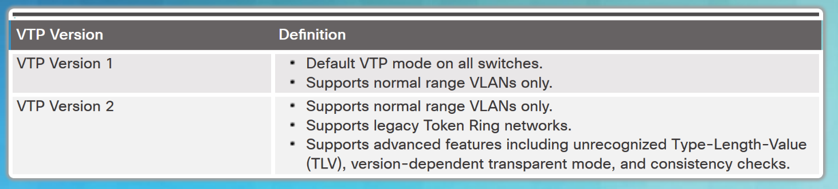
VTP Concepts and Operation VTP Versions
Switches in the same VTP domain must use the same VTP version.
Note: The newest version of VTP is Version 3, which is beyond the scope of this course.
Notes:
2.1 – VTP, Extended VLANs, and DTP
2.1.1 – VTP Concepts and Operation
2.1.1.4 – VTP Versions

Slide 21
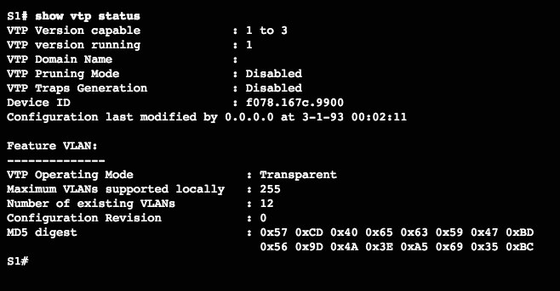
VTP Concepts and Operation Default VTP configuration
The show vtp status command displays the VTP status which includes the following:
VTP Version capable and running
VTP Domain Name
VTP Pruning Mode
VTP Traps Generation
Device ID
Configuration Last Modified
VTP Operating Mode
Maximum VLANs Supported Locally
Number of Existing VLANs
Configuration Revision
MD5 Digest
Verify Default VTP Status
Notes:
2.1 – VTP, Extended VLANs, and DTP
2.1.1 – VTP Concepts and Operation
2.1.1.5 – Default VTP configuration

Slide 22
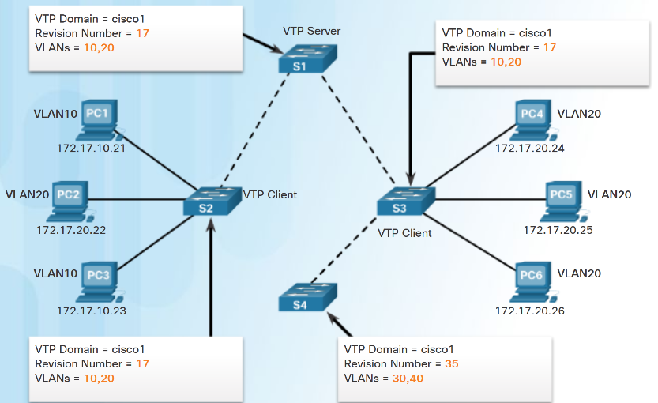
VTP Concepts and Operation VTP Caveats
VTP configuration revision number is stored in NVRAM.
To reset VTP configuration revision number to zero:
Change the switch's VTP domain to a nonexistent VTP domain and then change the domain back to the original name.
Change the switch's VTP mode to transparent and then back to previous VTP mode.
Notes:
2.1 – VTP, Extended VLANs, and DTP
2.1.1 – VTP Concepts and Operation
2.1.1.6 – VTP Caveats

Slide 23
VTP Concepts and Operation VTP Caveats (Cont.)
See graphic:
S4 is added. The startup config has not been erased and VLAN.DAT file on S4 has not been deleted. S4 has the same VTP domain name configured as other two switches but its revision number is 35, which is higher than the revision number on the other two switches.
S4 has VLAN 1 and is configured with VLAN 30 and 40. S4 does not have VLANs 10 and 20 in its database. Because S4 has a higher revision number, the rest of the switches in the domain will sync to S4’s revision.
Consequence is VLANs 10 and 20 will no longer exist on the switches, leaving clients that are connected to ports belonging to those non-existing VLANs without connectivity.
Notes:
2.1 – VTP, Extended VLANs, and DTP
2.1.1 – VTP Concepts and Operation
2.1.1.6 – VTP Caveats

Slide 24
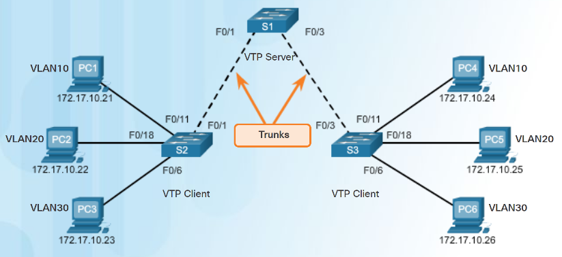
VTP Configuration VTP Configuration Overview
Steps to Configure VTP:
Step 1 - Configure the VTP Server
Step 2 - Configure the VTP Domain Name and Password
Step 3 - Configure the VTP Clients
Step 4 - Configure VLANs on the VTP Server.
Step 5 - Verify the VTP clients have received the new VLAN information.
Notes:
2.1 – VTP, Extended VLANs, and DTP
2.1.2 – VTP Configuration
2.1.2.1 – VTP Configuration Overview

Slide 25
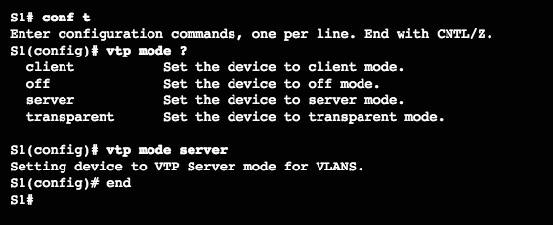
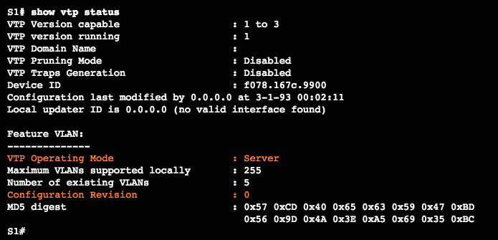
VTP Configuration Step 1 – Configure the VTP Server
Use the vtp mode server command to configure a switch as a VTP server.
Confirm all switches are configured with default configuration before issuing this command to avoid problems with configuration revision numbers.
Use the show vtp status to verify.
Notice configuration revision number is still set to 0 and number of existing VLANS is 5.
The 5 VLANs are the default VLAN 1 and VLANs 1002-1005.
Notes:
2.1 – VTP, Extended VLANs, and DTP
2.1.2 – VTP Configuration
2.1.2.2 – Step 1 – Configure the VTP Server

Slide 26
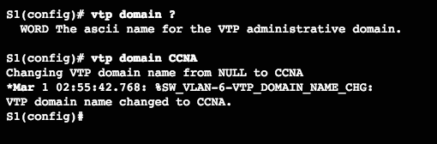
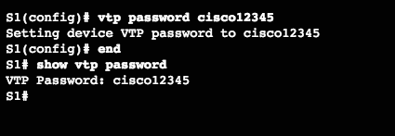
VTP Configuration Step 2 – Configure the VTP Domain Name and Password
Use the vtp domain domain-name command to configure the domain name.
VTP client must have same domain name as the VTP server before it will accept VTP advertisements.
Configure a password using the vtp password password command.
Use the show vtp password command to verify.
Notes:
2.1 – VTP, Extended VLANs, and DTP
2.1.2 – VTP Configuration
2.1.2.3 – Step 2 – Configure the VTP Domain Name and Password

Slide 27
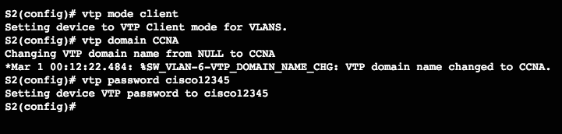
VTP Configuration Step 3 – Configure the VTP Clients
Use the vtp mode client command to configure the VTP clients.
Use same domain name and password as VTP server.
Notes:
2.1 – VTP, Extended VLANs, and DTP
2.1.2 – VTP Configuration
2.1.2.4 – Step 3 – Configure the VTP Clients

Slide 28
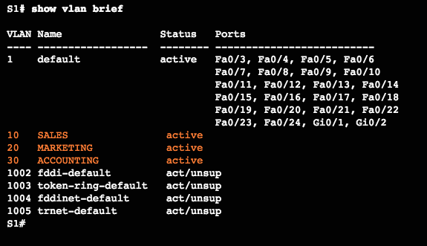
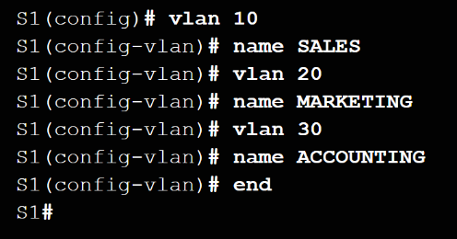
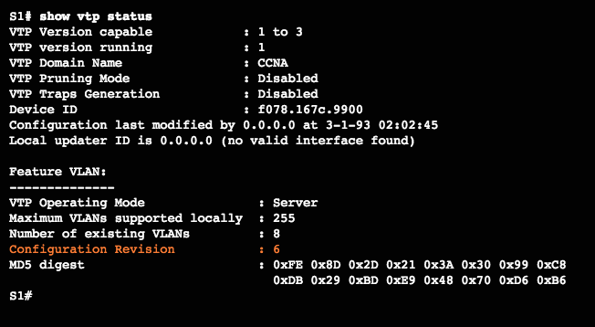
VTP Configuration Step 4 – Configure VLANs on the VTP Server
Use the vlan vlan-number command to create VLANs.
Use show vlan brief to verify the VLANs.
Use show vtp status to verify server status.
Every time a VLAN is added the configuration register is incremented
Notes:
2.1 – VTP, Extended VLANs, and DTP
2.1.2 – VTP Configuration
2.1.2.5 – Step 4 – Configure VLANs on the VTP Server

Slide 29
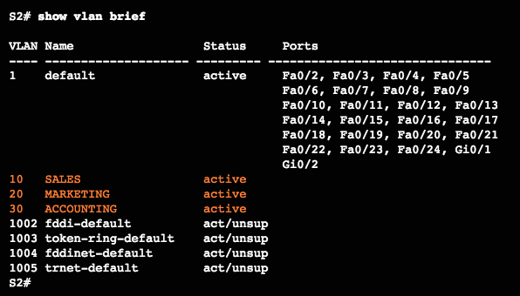
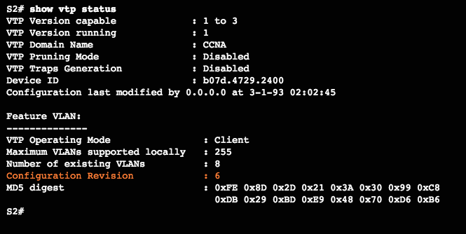
VTP Configuration Step 5 – Verify that the VTP Clients Have Received the New VLAN Information
Use the show vlan brief command to verify that the client received the new VLAN information.
Verify client status using the show vtp status command.
Notes:
2.1 – VTP, Extended VLANs, and DTP
2.1.2 – VTP Configuration
2.1.2.6– Step 5 – Verify that the VTP Clients Have Received the New VLAN Information

Slide 30
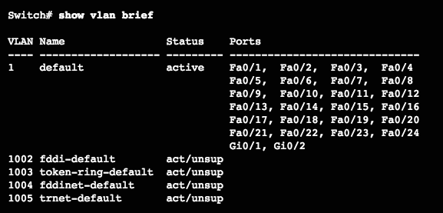
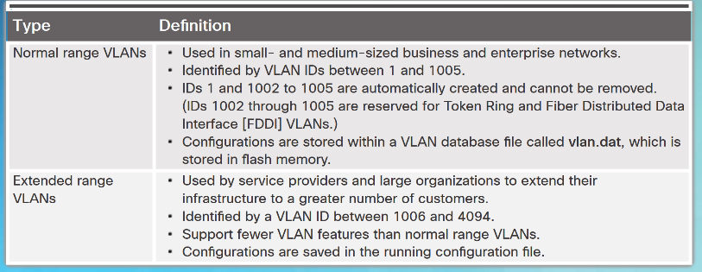
Extended VLANs VLAN Ranges on Catalyst Switches
Catalyst 2960 and 3560 Series switches support over 4,000 VLANs.
Normal range VLANs are numbered 1 to 1,005.
Stored in vlan.dat file
Extended range VLANs are numbered 1,006 to 4,094.
Not stored in vlan.dat file
VTP does not learn
Notes:
2.1 – VTP, Extended VLANs, and DTP
2.1.3 – Extended VLANs
2.1.3.1 – VLAN Ranges on Catalyst Switches

Slide 31
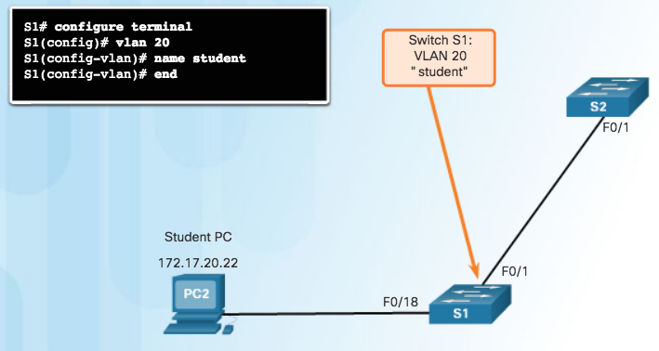
Extended VLANs Creating a VLAN
Normal range VLANs are stored in flash in vlan.dat
Use vlan vlan-id to create a VLAN
Use name vlan-name to name the VLAN
Naming each VLAN is considered a best practice in switch configuration.
To configure multiple VLANs, a series of VLAN IDs can be entered separated by commas, or a range of VLAN IDs separated by hyphens.
vlan 100,102,105-107
Notes:
2.1 – VTP, Extended VLANs, and DTP
2.1.3 – Extended VLANs
2.1.3.2 – Creating a VLAN

Slide 32
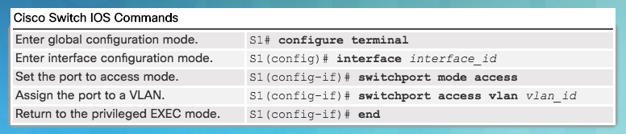
Extended VLANs Assigning Ports to VLANs
Access port can belong to only one VLAN at a time.
Only exception is when an IP phone is connected to the port. Then there are two VLANs associated with the port: one for voice and one for data.
Note: Use the interface range command to simultaneously configure multiple interfaces.
Notes:
2.1 – VTP, Extended VLANs, and DTP
2.1.3 – Extended VLANs
2.1.3.3 – Assigning Ports to VLANs

Slide 33
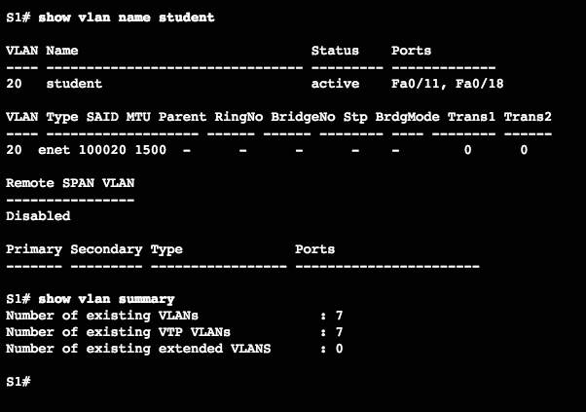
Extended VLANs Verifying VLAN Information
Commands to verify VLANs:
show vlan
show interfaces
show vlan name vlan-name
show vlan brief
show vlan summary
show interfaces vlan vlan-id
Notes:
2.1 – VTP, Extended VLANs, and DTP
2.1.3 – Extended VLANs
2.1.3.4 – Verifying VLAN Information

Slide 34
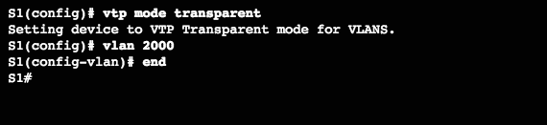
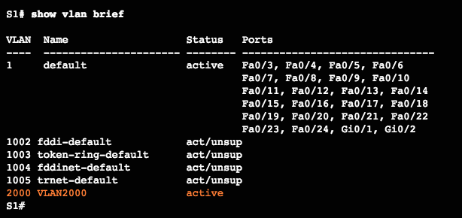
Extended VLANs Configuring Extended VLANs
Extended range VLANs are identified by a VLAN ID between 1006 and 4094.
To configure an extended VLAN on a 2960 switch it must be set to VTP transparent mode. (By default 2960 switches do not support Extended range VLANs.)
Notes:
2.1 – VTP, Extended VLANs, and DTP
2.1.3 – Extended VLANs
2.1.3.5 – Configuring Extended VLANs

Slide 35
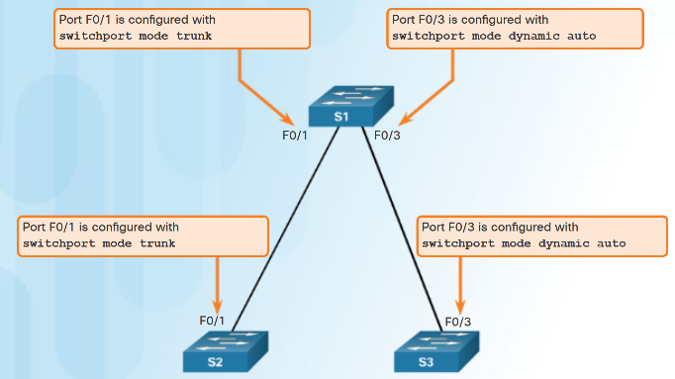
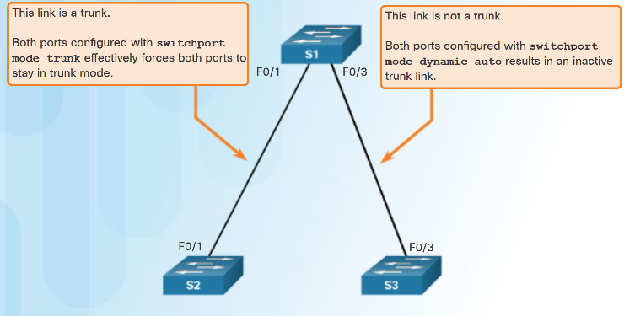
Dynamic Trunking Protocol Introduction to DTP
Trunk negotiation is managed by the Dynamic Trunking Protocol (DTP)
DTP is a Cisco proprietary protocol
automatically enabled on Catalyst 2960 and Catalyst 3560 Series switches.
To enable trunking from a Cisco switch to a device that does not support DTP, use the switchport mode trunk and switchport nonegotiate
Notes:
2.1 – VTP, Extended VLANs, and DTP
2.1.4 – Dynamic Trunking Protocol
2.1.4.1 – Introduction to DTP

Slide 36
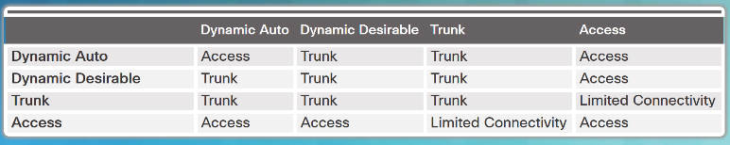
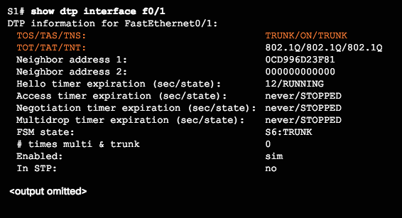
Dynamic Trunking Protocol Negotiated Interface Modes
Different trunking modes:
Switchport mode access - interface becomes a nontrunk interface.
Switchport mode dynamic auto - interface becomes a trunk if the neighboring interface is set to trunk or desirable mode.
Switchport mode dynamic desirable - interface becomes a trunk if the neighboring interface is set to trunk, desirable, or dynamic auto mode.
Switchport mode trunk - interface becomes a trunk even if the neighboring interface is not a trunk interface.
Switchport nonegotiate - prevents the interface from generating DTP frames.
Configure trunk links statically whenever possible.
Use show dtp interface to verify DTP.
Notes:
2.1 – VTP, Extended VLANs, and DTP
2.1.4 – Dynamic Trunking Protocol
2.1.4.2 – Negotiated Interface Modes

Slide 37
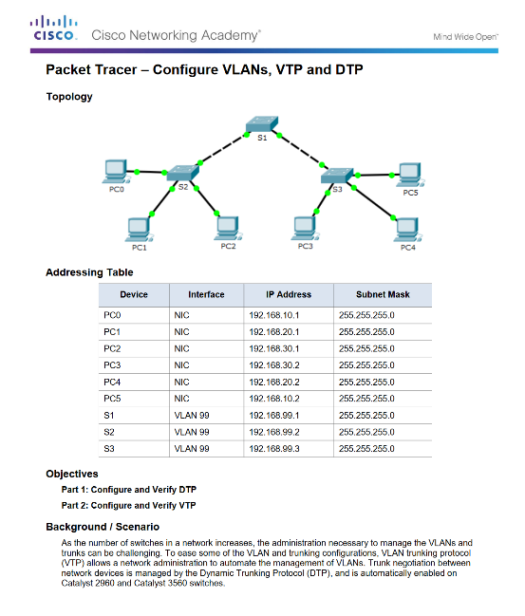
Dynamic Trunking Protocol Packet Tracer - Configure VTP and DTP
Notes:
2.1 – VTP, Extended VLANs, and DTP
2.1.4 – Dynamic Trunking Protocol
2.1.4.4 – Packet Tracer - Configure VTP and DTP

Slide 38
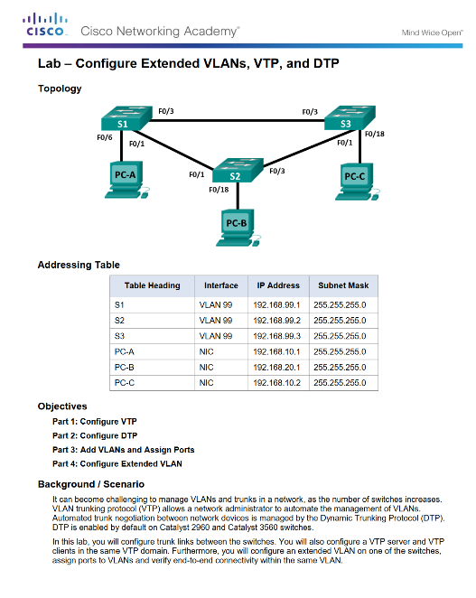
Dynamic Trunking Protocol Lab - Configure Extended VLANs, VTP and DTP
Notes:
2.1 – VTP, Extended VLANs, and DTP
2.1.4 – Dynamic Trunking Protocol
2.1.4.5 – Lab - Configure Extended VLANs, VTP and DTP

Slide 39
2.2 Troubleshoot Multi-VLAN Issues
Notes:
2 – Scaling VLANs
2.2 – Troubleshoot Multi-VLAN issues

Slide 40
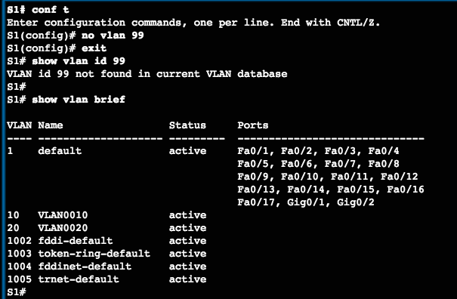
Inter-VLAN Configuration Issues Deleting VLANs
Assume S1 has VLANs 10, 20, and 99 configured, VLAN 99 is assigned to ports Fa0/18 through Fa0/24.
Deleting a VLAN from a switch that is in VTP server mode removes the VLAN from all switches in the VTP domain.
Note: You cannot delete the default VLANs (i.e., VLAN 1, 1002 - 1005).
Use the no vlan vlan-id global configuration mode command to delete a VLAN.
Any ports assigned to that VLAN become inactive. They remain inactive until assigned to a new VLAN.
Notes:
2.2 – Troubleshoot Multi-VLAN Issues
2.2.1 – Inter-VLAN Configuration Issues
2.2.1.1 –Deleting VLANs

Slide 41
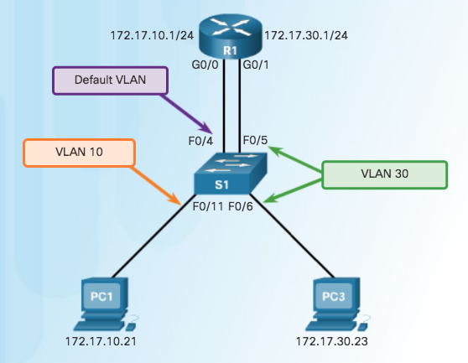
Inter-VLAN Configuration Issues Switch Port Issues
When using the legacy routing model for inter-VLAN routing, the switch ports connected to the router interfaces must be configured with the correct VLANs.
S1 F0/4 is in the default VLAN
Must be in access mode, VLAN 10
Notes:
2.2 – Troubleshoot Multi-VLAN Issues
2.2.1 – Inter-VLAN Configuration Issues
2.2.1.2 –Switch Port Issues

Slide 42
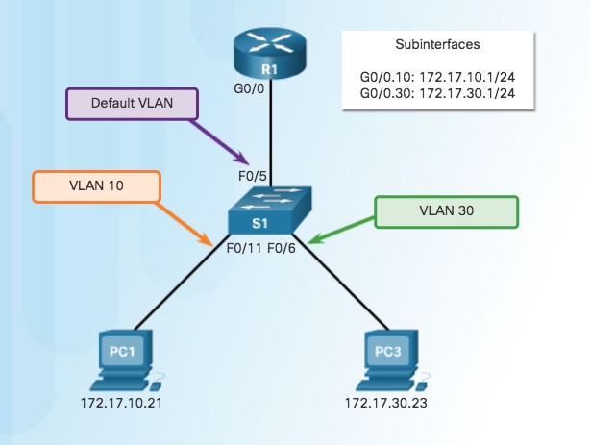
Inter-VLAN Configuration Issues Switch Port Issues (Cont.)
When using the router-on-a-stick routing model the interface on the switch connected to the router must be configured as a trunk port.
INCORRECT
Interface F0/5 on switch S1 is not configured as a trunk and is left in the default VLAN for the port
Notes:
2.2 – Troubleshoot Multi-VLAN Issues
2.2.1 – Inter-VLAN Configuration Issues
2.2.1.2 –Switch Port Issues

Slide 43
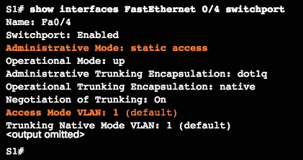
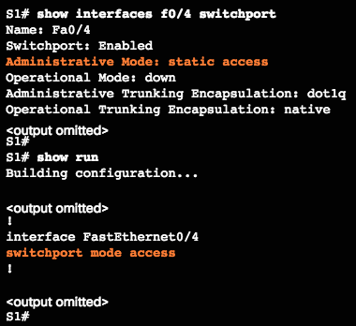
Inter-VLAN Configuration Issues Verify Switch Configuration
Commands to verify switch configuration:
show interfaces interface-id switchport
show running-config
Notes:
2.2 – Troubleshoot Multi-VLAN Issues
2.2.1 – Inter-VLAN Configuration Issues
2.2.1.3 –Verify Switch Configuration

Slide 44
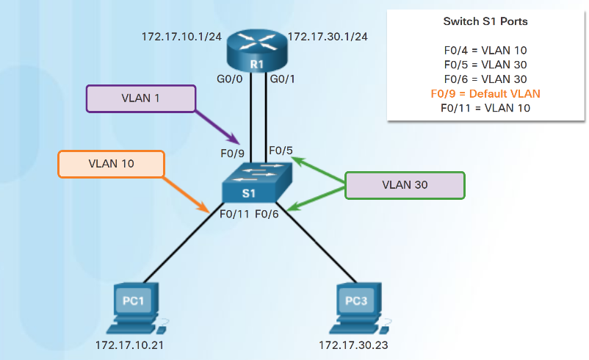
Inter-VLAN Configuration Issues Interface Issues
When enabling inter-VLAN routing on a router, one of the most common configuration errors is to connect the physical router interface to the wrong switch port.
Notes:
2.2 – Troubleshoot Multi-VLAN Issues
2.2.1 – Inter-VLAN Configuration Issues
2.2.1.4 –Interface Issues

Slide 45
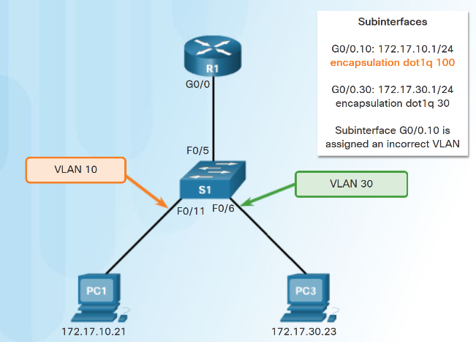
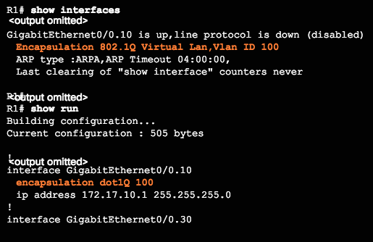
Inter-VLAN Configuration Issues Verify Routing Configuration
With router-on-a-stick configurations, a common problem is assigning the wrong VLAN ID to the subinterface.
Use show interfaces and the show running-config commands to verify the routing configurations.
Notes:
2.2 – Troubleshoot Multi-VLAN Issues
2.2.1 – Inter-VLAN Configuration Issues
2.2.1.5 –Verify Routing Configuration

Slide 46
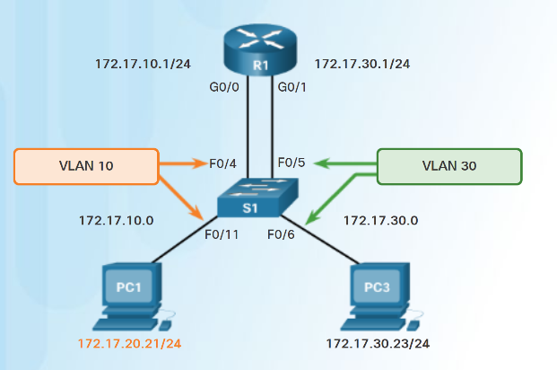
IP Addressing Issues Errors with IP Addresses and Subnet Masks
For inter-VLAN routing to operate, a router must be connected to all VLANs, either by separate physical interfaces or by subinterfaces.
Each interface, or subinterface, must be assigned an IP address that corresponds to the subnet to which it is connected.
Each PC must be configured with an IP address within the VLAN it is assigned to.
Incorrect IP address
Notes:
2.2 – Troubleshoot Multi-VLAN Issues
2.2.2 – IP Addressing Issues
2.2.2.1 – Errors with IP Addresses and Subnet Masks

Slide 47
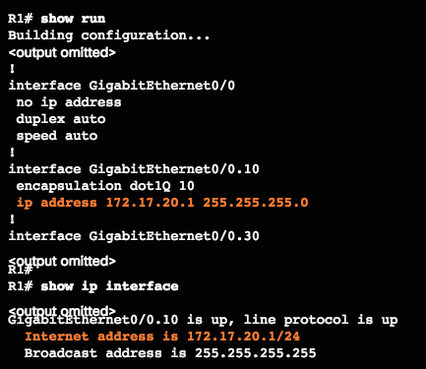
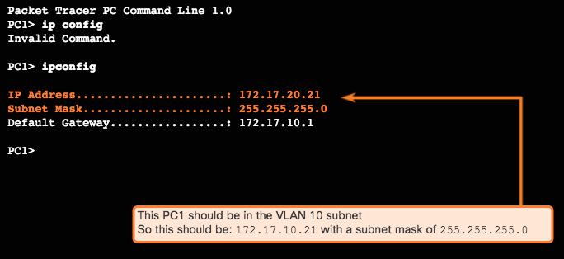
IP Addressing Issues Verifying IP Address and Subnet Mask Configuration Issues
A common error is to incorrectly configure an IP address for a subinterface.
Use show run and show ip interface to verify IP addressing.
Another error is incorrectly addressing the end device.
Use ipconfig to verify the address on a Windows PC
Notes:
2.2 – Troubleshoot Multi-VLAN Issues
2.2.2 – IP Addressing Issues
2.2.2.2 – Verifying IP Address and Subnet Mask Configuration Issues

Slide 48
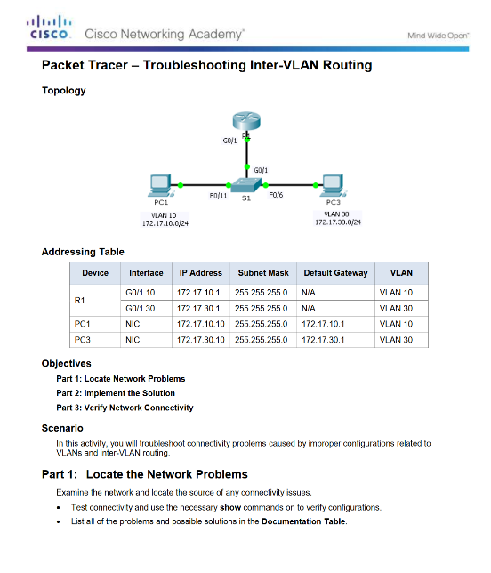
IP Addressing Issues Packet Tracer - Troubleshooting Inter-VLAN Routing
Notes:
2.2 – Troubleshoot Multi-VLAN Issues
2.2.2 – IP Addressing Issues
2.2.2.4 – Packet Tracer - Troubleshooting Inter-VLAN Routing

Slide 49
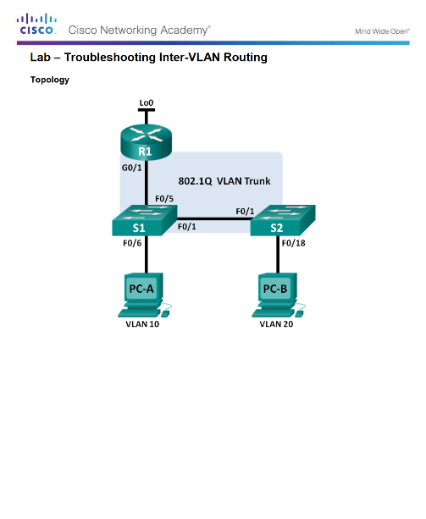
IP Addressing Issues Lab - Troubleshooting Inter-VLAN Routing
Notes:
2.2 – Troubleshoot Multi-VLAN Issues
2.2.2 – IP Addressing Issues
2.2.2.5 – Lab - Troubleshooting Inter-VLAN Routing

Slide 50
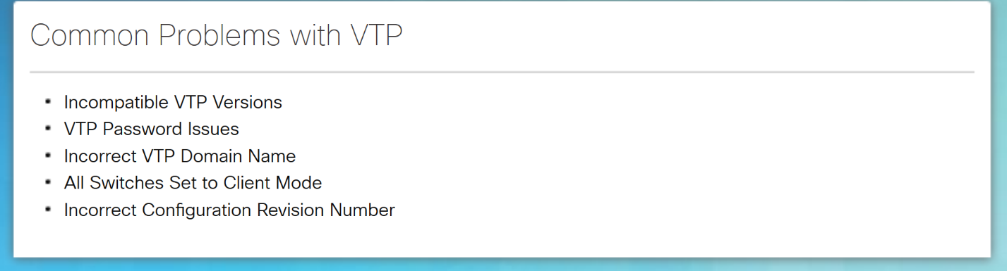
VTP and DTP Issues Troubleshoot VTP Issues
Notes:
2.2 – Troubleshoot Multi-VLAN Issues
2.2.3 – VTP and DTP Issues
2.2.3.1 – Troubleshoot VTP Issues

Slide 51
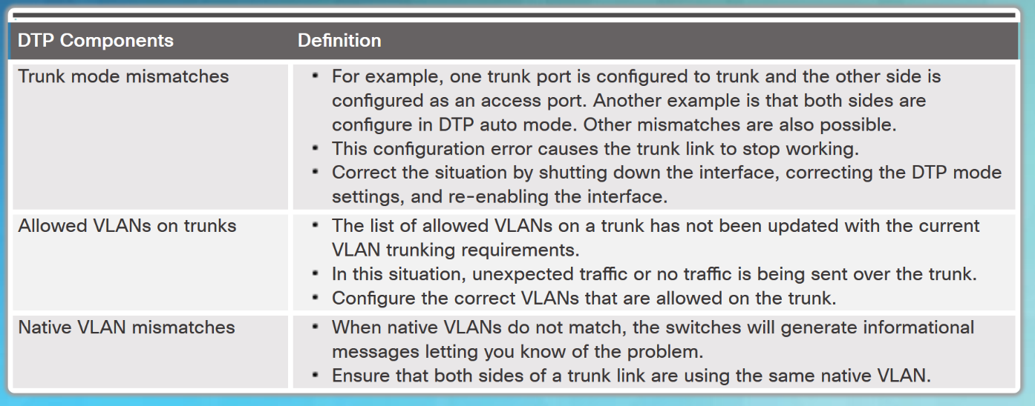
VTP and DTP Issues Troubleshoot DTP Issues
Common Problems with Trunks
Notes:
2.2 – Troubleshoot Multi-VLAN Issues
2.2.3 – VTP and DTP Issues
2.2.3.2 – Troubleshoot DTP Issues

Slide 52
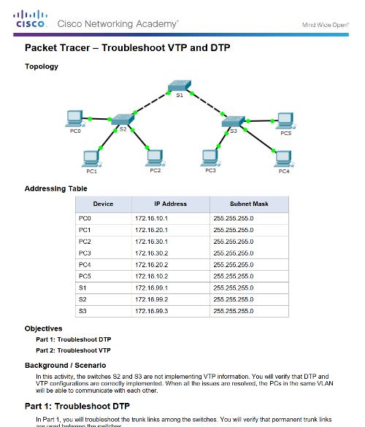
VTP and DTP Issues Packet Tracer - Troubleshoot VTP and DTP Issues
Notes:
2.2 – Troubleshoot Multi-VLAN Issues
2.2.3 – VTP and DTP Issues
2.2.3.3 – Packet Tracer - Troubleshoot VTP and DTP Issues

Slide 53
2.3 Layer 3 Switching
Notes:
2 – Scaling VLANs
2.3 – Layer 3 Switching

Slide 54
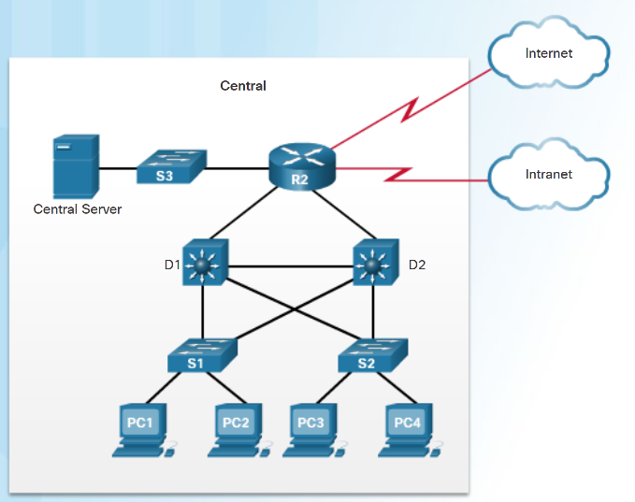
Layer 3 Switching Operation and Configuration Introduction to Layer 3 Switching
Multilayer switches provide high-packet processing rates using hardware-based switching.
Catalyst multilayer switches support the following types of Layer 3 interfaces:
Routed port - A layer 3 interface
Switch virtual interface (SVI) - Virtual Interface for inter- VLAN routing
All Layer 3 Cisco Catalyst switches support routing protocols, but several models require enhanced software for specific routing protocol features.
Catalyst 2960 Series switches running IOS 12.2(55) or later, support static routing.
Notes:
2.3 – Layer 3 Switching
2.3.1 – Layer 3 Switching Operation and Configuration
2.3.1.1 – Introduction to Layer 3 Switching

Slide 55
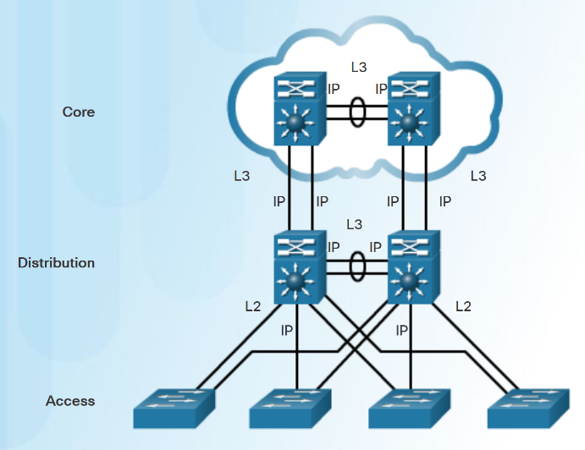
Layer 3 Switching Operation and Configuration Inter-VLAN Routing with Switch Virtual Interfaces
In the early days of switched networks, switching was fast and routing was slow. Therefore the layer 2 switching portion was extended as much as possible into the network.
Now routing can be performed at wire speed, and is performed at both the distribution and core layers.
Distribution switches are configured as Layer 3 gateways using Switch Virtual Interfaces (SVIs) or routed ports.
Routed ports are usually implemented between the distribution and core layers.
Notes:
2.3 – Layer 3 Switching
2.3.1 – Layer 3 Switching Operation and Configuration
2.3.1.2 – Inter-VLAN Routing with Switch Virtual Interfaces

Slide 56
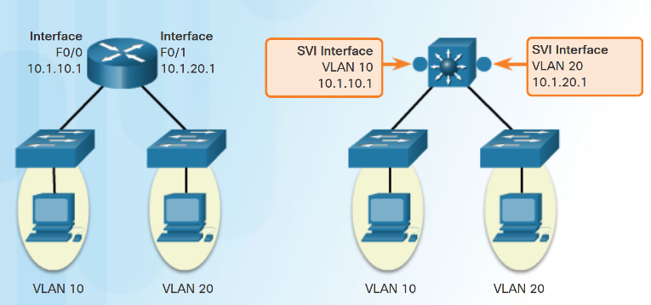
Layer 3 Switching Operation and Configuration Inter-VLAN Routing with Switch Virtual Interfaces (Cont.)
An SVI is a virtual interface that is configured within a multilayer switch:
To provide a gateway for a VLAN so that traffic can be routed into or out of that VLAN.
To provide Layer 3 IP connectivity to the switch.
To support routing protocol and bridging configurations.
Advantages of SVIs:
Faster than router-on-a-stick.
No need for external links from the switch to the router for routing.
Not limited to one link. Layer 2 EtherChannels can be used to get more bandwidth.
Notes:
2.3 – Layer 3 Switching
2.3.1 – Layer 3 Switching Operation and Configuration
2.3.1.3 – Inter-VLAN Routing with Switch Virtual Interfaces (Cont.)

Slide 57

Layer 3 Switching Operation and Configuration Inter-VLAN Routing with Routed Ports
A routed port is a physical port that acts similarly to an interface on a router:
It is not associated with a particular VLAN.
It does not support subinterfaces.
Routed ports are primarily configured between switches in the core and distribution layer.
Use the no switchport interface command on the appropriate port to configure a routed port.
Note: Routed ports are not supported on Catalyst 2960 Series switches.
Notes:
2.3 – Layer 3 Switching
2.3.1 – Layer 3 Switching Operation and Configuration
2.3.1.4 – Inter-VLAN Routing with Routed Ports

Slide 58

Layer 3 Switching Operation and Configuration Packet Tracer - Configure Layer 3 Switching and Inter-VLAN routing
Notes:
2.3 – Layer 3 Switching
2.3.1 – Layer 3 Switching Operation and Configuration
2.3.1.5 – Packet Tracer - Configure Layer 3 Switching and Inter-VLAN routing

Slide 59

Troubleshoot Layer 3 Switching Layer 3 Switch Configuration Issues
To troubleshoot Layer 3 switching issues check the following:
VLANs – verify correct configuration.
SVIs - verify correct IP, subnet mask and VLAN number.
Routing - verify that either static or dynamic routing is correctly configured and enabled.
Hosts – verify correct IP, subnet mask, and default gateway.
Notes:
2.3 – Layer 3 Switching
2.3.2 – Troubleshoot Layer 3 Switching
2.3.2.1 – Layer 3 Switch Configuration Issues

Slide 60

Troubleshoot Layer 3 Switching Example: Troubleshooting Layer 3 Switching
There are four steps to implementing a new VLAN:
Step 1. Create and name a new VLAN 500 on the fifth floor switch and on the distribution switches.
Step 2. Add ports to VLAN 500 and ensure that the trunk is set up between distribution switches.
Step 3. Create an SVI interface on the distribution switches and ensure that IP addresses are assigned.
Step 4. Verify connectivity.
The troubleshooting plan checks for the following:
Step 1. Verify that all VLANs have been created.
Step 2. Ensure that ports are in the right VLAN and trunking is working as expected.
Step 3. Verify SVI configurations.
Notes:
2.3 – Layer 3 Switching
2.3.2 – Troubleshoot Layer 3 Switching
2.3.2.2 – Example: Troubleshooting Layer 3 Switching

Slide 61
2.3 Chapter Summary
Notes:
2 – Scaling VLANs
2.3 – Summary

Slide 62
Conclusion Chapter 2: Scaling VLANs
Configure enhanced inter-switch connectivity technologies.
Troubleshoot issues in an inter-VLAN routing environment.
Implement inter-VLAN routing using Layer 3 switching to forward data in a small to medium-sized business LAN.
Notes:
2.3 – Summary
2.3.1 – Conclusion
2.3.1.1 – Chapter 2: Scaling VLANs

Slide 63
Chapter 2: Scaling VLANs New Terms and Commands
virtual local area networks (VLANs) trunks VLAN Trunking Protocol (VTP) Dynamic Trunking Protocol (DTP) extended range VLANs vlan.dat VTP Domain VTP Advertisements VTP Modes VTP Server VTP Client VTP Transparent Summary advertisements Advertisement request | Subset advertisements normal range VLANs inter-VLAN routing legacy inter-VLAN routing router-on-a-stick inter-VLAN routing Layer 3 inter-VLAN routing Routed port Switch Virtual Interface (SVI) Cisco Express Forwarding
Notes:
New Terms and Commands

